Slide 1
Data structures and algorithms In JavaScript

Slide 2
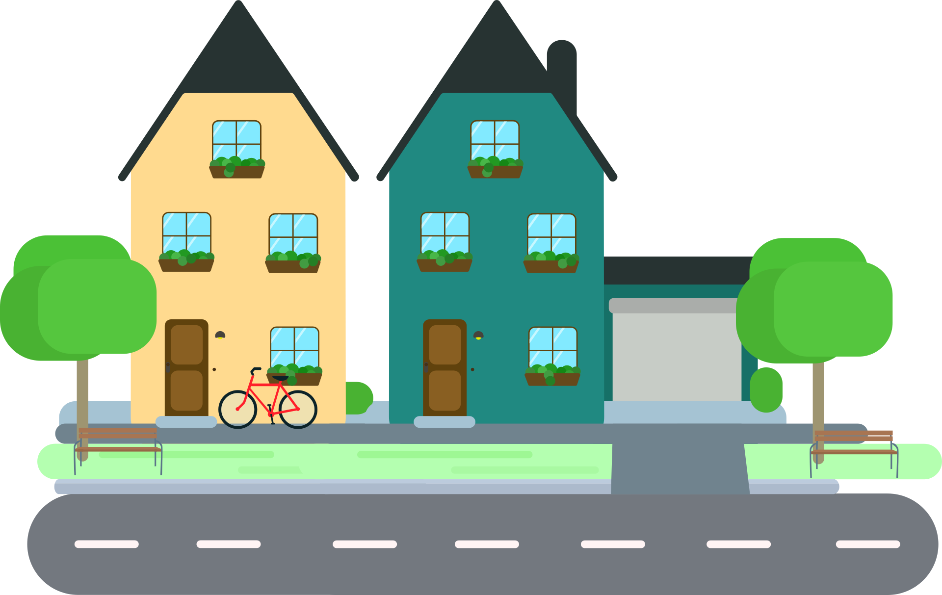

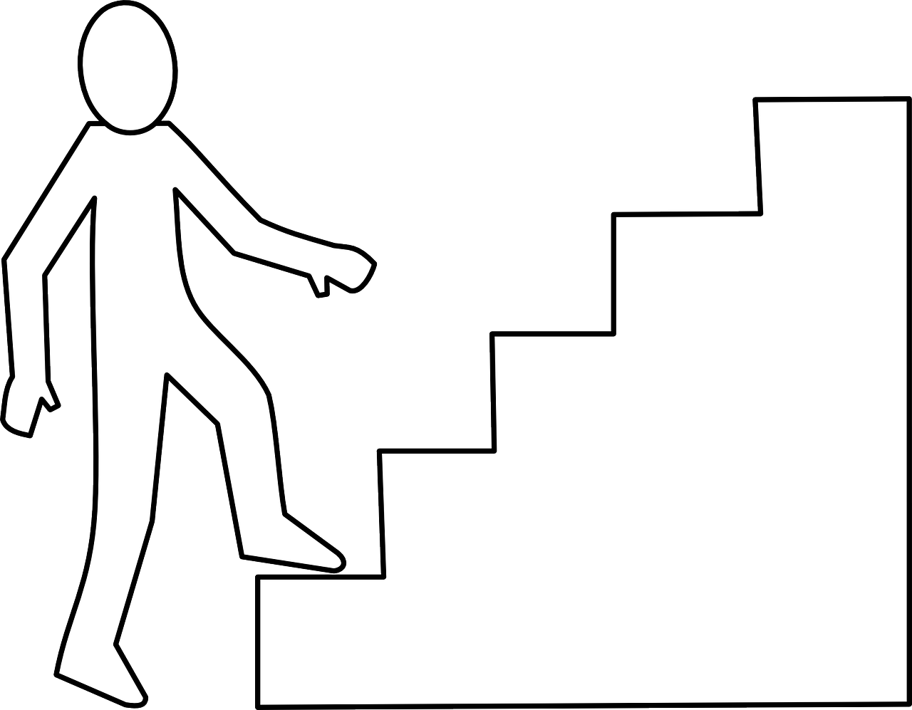
Algorithms In our life
Algorithm:
set of steps that will solve a particular problem for us.
Algorithm1
Walk to your home
Use stairs to go up
More Time
Less Money
More Energy

Slide 3
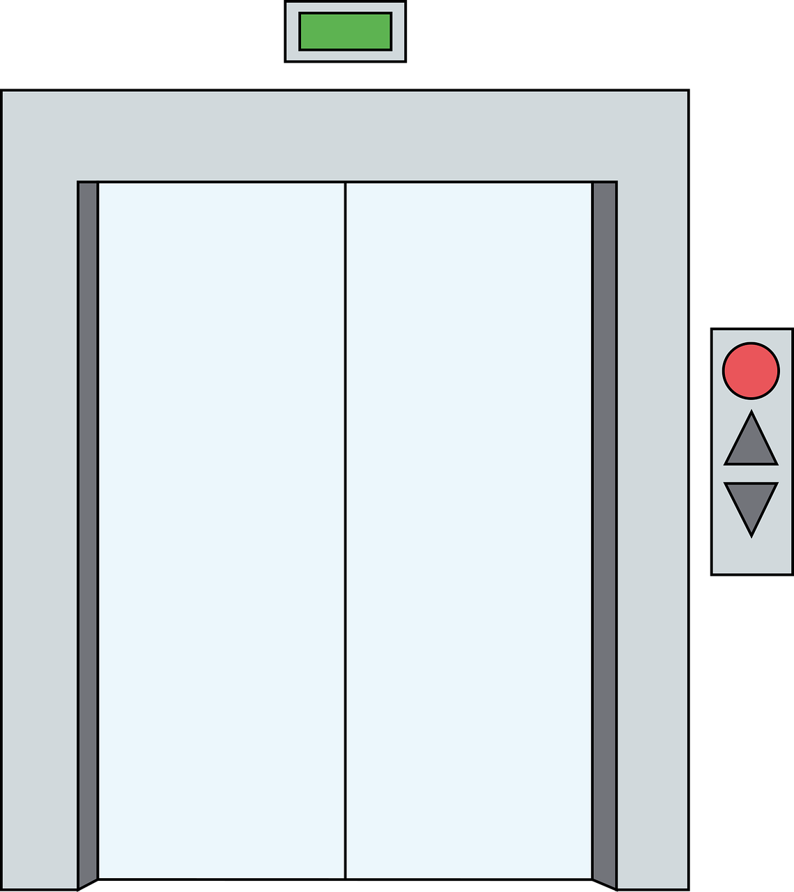

Algorithms In our life
Algorithm:
set of steps that will solve a particular problem for us.
Algorithm2
Take a Taxi
Use the elevator
Less Time
More Money
Less Energy

Slide 4
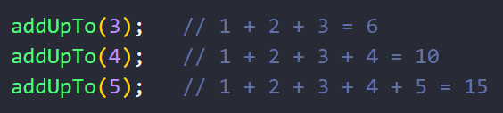
How can we Compare Algorithms
Example
Write a function called addUpTo that takes a number (n)
and returns the sum of all the numbers from 1 to n

Slide 5
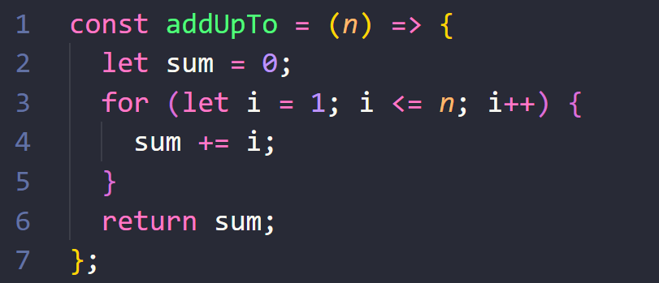
Solution 1

Slide 6
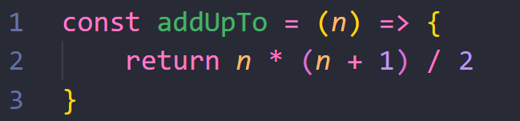
Solution 2

Slide 7

Solution 2
addUpToN(n) = 1 + 2 + ……………… + (n – 1) + n
addUpToN(n) = n + (n – 1) + ……………… + 2 + 1
------------------------------------------------------------
2addUpToN(n) = (n + 1) + (n + 1) + …………… + (n + 1) + (n + 1)
2addUpToN(n) = n * (n + 1)
$$addUpToN(n)=\frac{n ∗ (n+1)}{2}$$

Slide 8

How to choose?
More readable
Take Less lines of code
Faster in execution (Less time)
Less memory (less variables)
Time
Space

Slide 9
Time complexity
May be according to the time each one takes

Slide 10
Time complexity
Why Time cannot be used as a unit?
Vary from device to device
Vary in the same device
Don’t give us an accurate measure
We need a unit to be constant at different platforms and devices
So we can use it

Slide 11
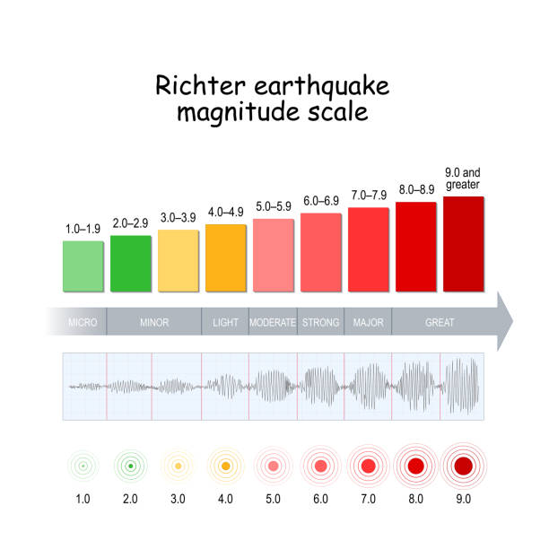
Which one to choose?

Slide 12

Assignment
Freecodecamp
https://www.freecodecamp.org/learn/javascript-algorithms-and-data-structures/#basic-algorithm-scripting
[6 – 10]

